Slide 1
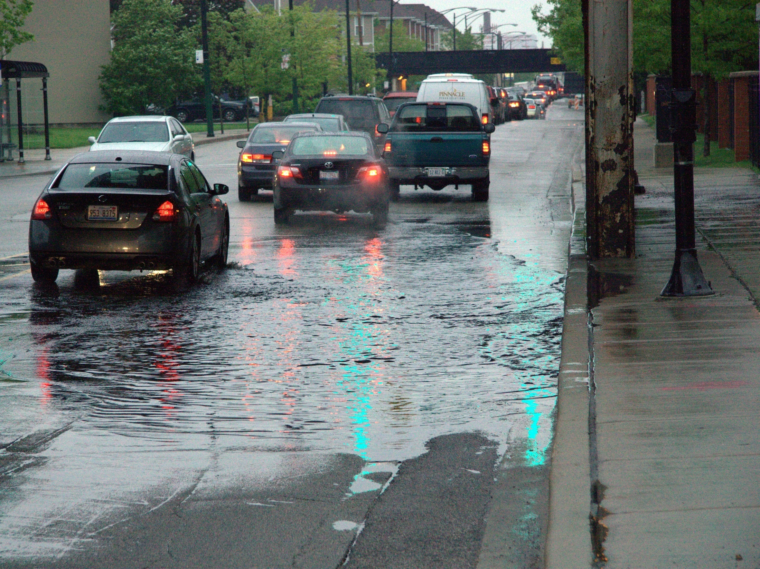

Flooding Resilience Plan for Bus Operations
IDENTIFY – ASSESS – MITIGATE
Project Summary Presentation March 2018

Slide 2
Project Scope
Task 2:
Identify and Map Flooding Impacts
Project Kickoff Meeting
Task 1: Project Kickoff Meeting
Task 4;
Resilience Plan
Task 3:
Future Climate Change Impact on Flooding

Slide 3
current risks and areas of concern

Slide 4
Task 2: Identify and Map Flood
Impacts
2
Scope / Tasks
Deliverables
Identify flood risk areas through mapping exercises
Obtain stakeholder input
Map bus routes and facilities
Develop prioritization and risk assessment matrix
Select highest risk routes for reroute planning
Tech memo summarizing findings, including maps and route selection
Stakeholder interview plan and notes
Steering Committee meeting
Stakeholder Interviews
Meetings

Slide 5
Stakeholder Interviews
Organization | Contact
Chicago Department of Transportation (CDOT) | Joe Alonzo, Transportation Planner Mike Drake, General Superintendent, Division of In-House Construction Tony Rainey, Civil Engineer
Chicago Department of Water Management (CDM) | Sid Osakada, Coordinating Engineer Anupam Verma, PE, Managing Engineer - Water Management
Chicago Metropolitan Agency for Planning (CMAP) | Jason Navota, Director Nora Beck, Senior Planner
Chicago Office of Emergency Management and Communications (OEMC) | Chris Pettineo, Manager of Emergency Management Services Peter Raber, Senior Emergency Management Coordinator
Cook County Department of Transportation and Highways (CCDOTH) | Maria Choca-Urban, Director of Strategic Planning and Policy
Cook County Department of Homeland Security and Emergency Management (CCDHSEM) | Dana Curtiss, Operations Information Support Manager, Office of the President
DuPage County Stormwater Management | Christine Klepp, Senior Project Engineer, Stormwater Management Chris Vonnahme, Senior Project Engineer, Dept of Econ. Dev. & Planning
DuPage County Department of Transportation (DCDOT) | John Loper, Director of Transportation Planning
Illinois Department of Transportation (IDOT) | Rick Wojcik, IDOT Hydraulics
Metropolitan Water Reclamation District (MWRD) | Joe Kratzer, PE, CFM, Managing Civil Engineer, Engineering Dept/SW Mgmt Greg Koch, PE, Principal Civil Engineer, Engineering Dept/SW Mgmt
US Army Corps of Engineers (USACE) | Sarah Brodcinski Sue Davis, Planning Division Chief
Will County Division of Transportation (WCDOT) | Christina Kupkowski, PE, Phase I Project Manager Raymond A. Semplinski, Maintenance Administrator

Slide 6
Stakeholder Interviews
  Inconsistent documentation of actual / historical flood incidents
    Technology / format varies; ownership varies
    Datasets dependent upon what others report, not a regular sampling / survey
    Timeframes also dependent on what is reported
  Flooding has different root causes
    Urban flooding not predicted by location relative to floodplains and floodways
  Lots of activity across the region
    Active stormwater management projects in process – changing the boundaries of flood risk areas
    Need to keep open communication
    Wide-area stormwater management programs and plans
      FEMA-compliant All-Hazard Mitigation Plans or Natural Hazard Mitigation Plans
      Focus area in CMAP’s ON TO 2050
    Forecasting & application innovations

Slide 7
Scenarios for identifying routes
Pace | CTA
Scenario A - Routes with reported flooding and located in flood zones, sorted by ridership
Only routes with flooding noted by Pace Routes then sorted by number of flood zones they traverse, and then by average monthly weekday ridership | Only routes with flooding incidents recorded by CTA Routes then sorted by number of recorded flood incidents they intersect, number of flood zones they traverse, and then by average daily weekday ridership
Scenario B - Routes with reported flooding, sorted by ridership
Only routes with flooding noted by Pace Routes then sorted by average monthly weekday ridership | Only routes with flooding incidents recorded by CTA Routes then sorted by number of recorded flood incidents they intersect, and then by average daily weekday ridership
Scenario C - Routes in flood zones, sorted by ridership
Only routes that traverse flood zones Routes then sorted by number of flood zones they traverse, then by average monthly weekday ridership | Only routes that traverse flood zones Routes then sorted by number of flood zones they traverse, then by average daily weekday ridership
Scenario D - Routes with reported flooding or located in flood zones, sorted by ridership
Only routes with flooding noted by Pace or that traverse flood zones Routes then sorted by average monthly weekday ridership | Only routes with flooding incidents recorded by CTA or that traverse flood zones Routes then sorted by average daily weekday ridership
Scenario E - Routes with reported flooding, sorted by system connectivity and ridership
Only routes with flooding noted by Pace Routes then sorted by number the number of connections they have with CTA rail or Metra rail stations, then by average monthly weekday ridership | Only routes with flooding incidents recorded by CTA Routes then sorted by number the number of connections they have with CTA rail or Metra rail stations, then by average daily weekday ridership
Scenario F – Trunk Service Routes
N/A | “Workhorses” of the CTA network, moving large volumes of passengers across the city and making vital connections between transit modes, as well as connecting residential communities to central business district and other employment centers.

Slide 8
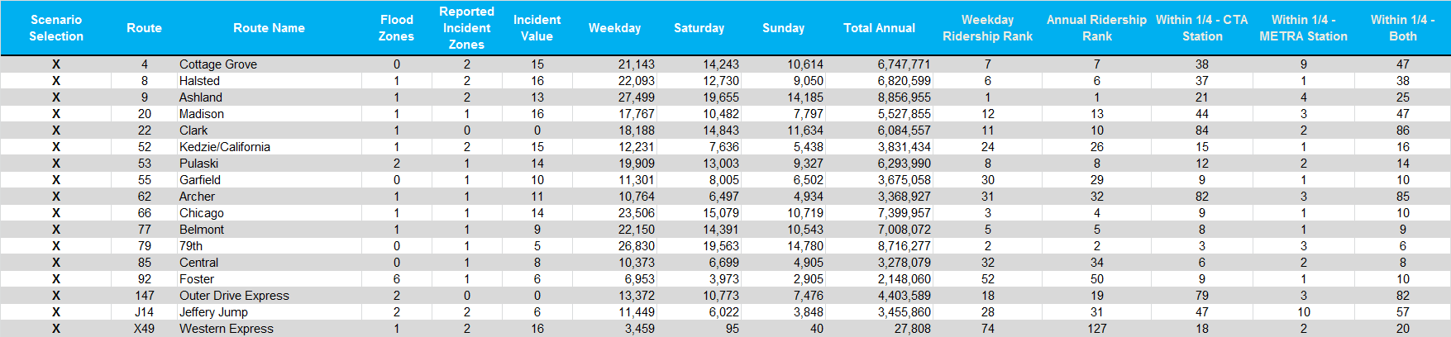
Scenarios for identifying routes
CTA Scenario F

Slide 9
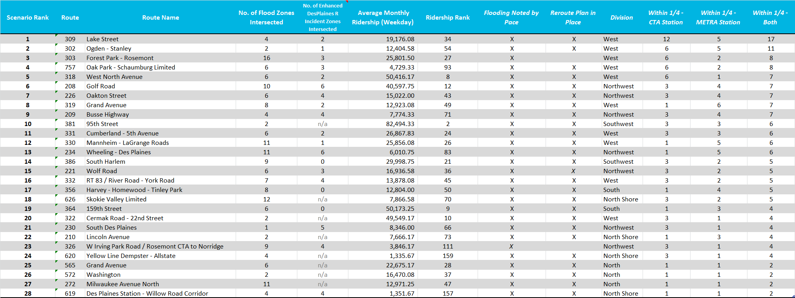
Scenarios for identifying routes
Pace Scenario E

Slide 10
future climate change risk analysis

Slide 11
Task 3: Future Climate Change Impact on Flooding
3
Scope / Tasks
Deliverables
Analyze existing climate change data and apply the data to develop a revised footprint for potential flooding
Update the vulnerability risk matrix
Confirm or revise selection of bus routes for re-route planning
Tech memo / presentation summarizing climate impact projections, analysis findings, including revised maps and route recommendations
Steering Committee meeting
Meetings

Slide 12
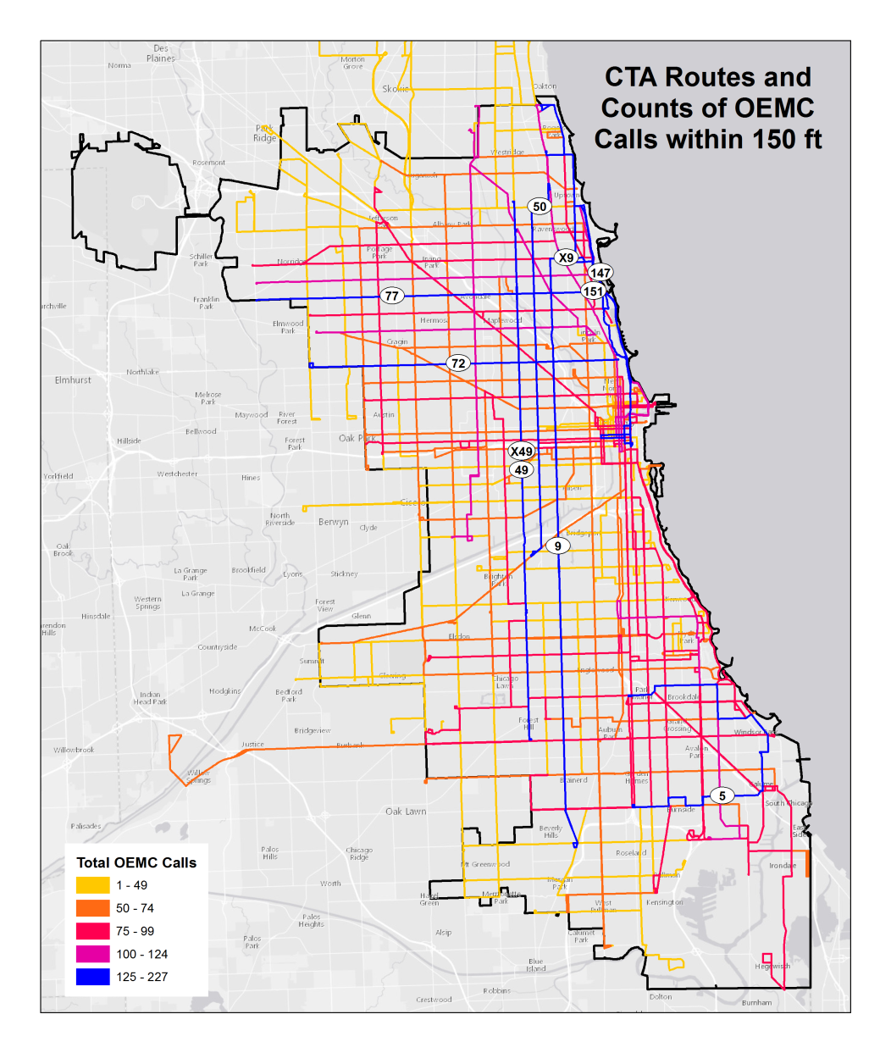
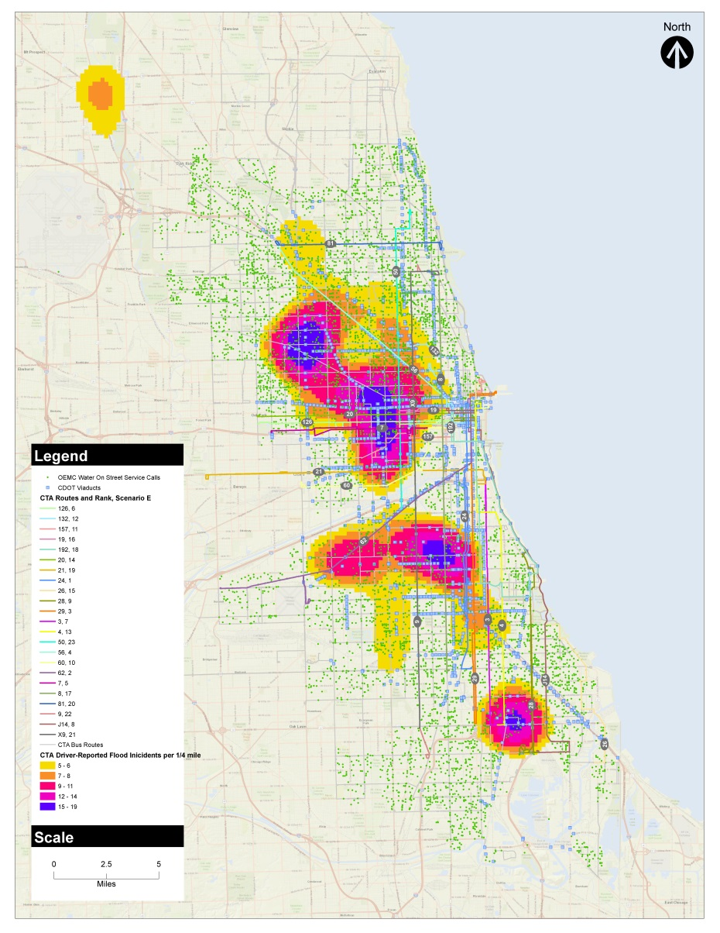
Urban Flooding Data Analysis
OEMC Street Flood Calls, CTA Driver Flood Reports, CDOT Viaducts, and CTA Top Routes (Scenario E)
CTA Routes by proximity of OEMC Street & Viaduct Flood Calls

Slide 13
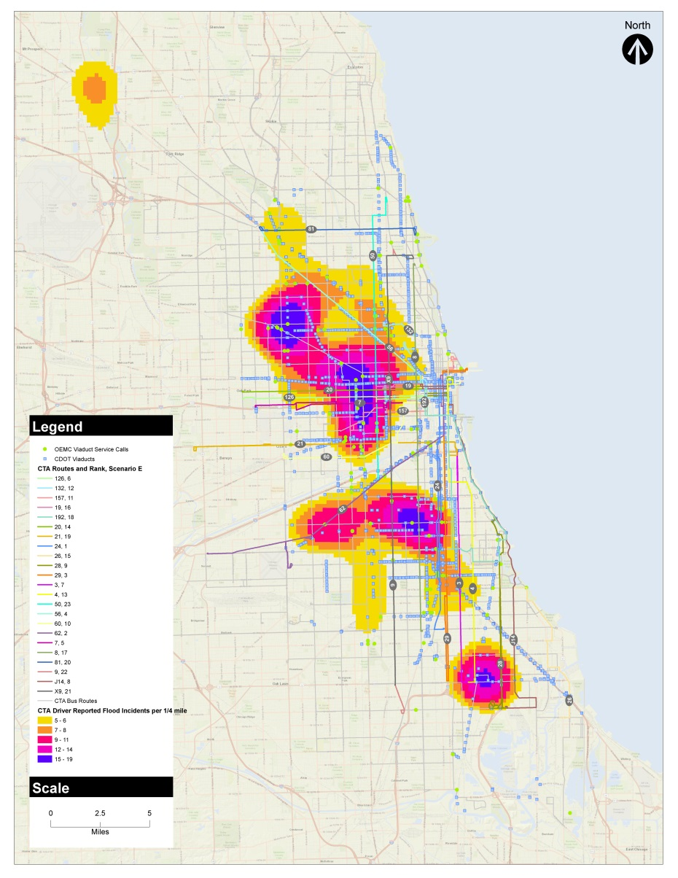
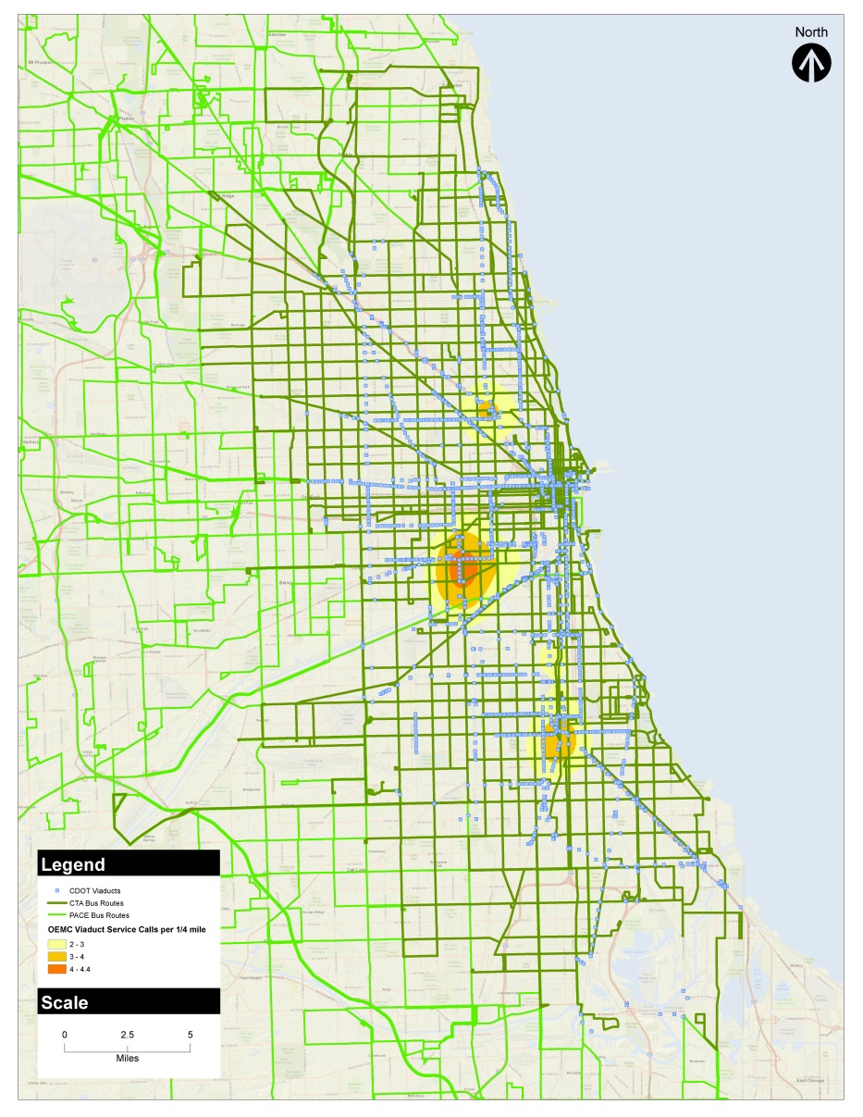
Urban Flooding Data Analysis
CDOT Viaducts, OEMC Viaduct Flood Calls and CTA Driver Flood Reports
Bus Routes, CDOT Viaducts and OEMC Viaduct Flood Calls

Slide 14
Data and areas of concern: a Tale of Two floods
River Systems Data Sets
Infrastructure / Incidents Data
FEMA 100-year and 500-year floodplain boundaries
Local updates on floodplain boundaries / inundation areas from counties (Cook/MWRD, DuPage, Will)
CTA reported flood locations
Pace reported reroute / flood locations
CCDOTH road closures
CDOT viaducts
City of Chicago 311 reported flood calls
Less developed / built
Suburban/exurban
Root: natural systems overflow
More developed / built
Urban
Root: infrastructure capacity, local drainage

Slide 15
Methods for evaluating climate change data and potential future flooding patterns
Rainfall Frequency Adjustment for Climate Change
Generalized modeling of anticipated rainfall suggests storms of greater severity may occur more frequently in the future. That is….
The term Storm Recurrence Interval refers to the chance or probability that a storm of a certain magnitude may occur or be exceeded in a given year.
For example, a 100-year storm has a 1 in 100 chance of occurring in any given year, or 1% chance (called the Annual Exceedance Probability).
It does not mean that such a storm only occurs once every 100 years, and once happened, won’t happen again in the same 100-year period.
For severe storms:
  100-year storm mid-century could be like today’s 150-year storm
  100-year storm end-century could be like today’s 240-year storm
For moderate storms:
  5-year storm mid-century could be like today’s 11-year storm
  5-year storm end-century could be like today’s 14-year storm
  1-year storm mid-century could be like today’s 2-year storm
  1-year storm end-century could be like today’s 2.5-year storm

Slide 16
Methods for evaluating climate change data and potential future flooding patterns
Rainfall Frequency Adjustment for Climate Change
Mid-Century Adjusted Rainfall
Averaged the increases for future climate change scenarios (B1, A1B, and A2)
Plotted the 2-, 10-, and 100-yr adjustments on log-log paper to determine adjustments for other storms
Added adjustments to the Bulletin 70 24-hr rainfall amounts
Plotted these values on log-log paper
Interpolated existing and future rainfall frequency curves to identify the equivalent storm frequency for the future rainfall events
Late-Century Adjusted Rainfall
Sources: Illinois State Water Survey Contract Report 2016-05; ISWS Bulletin 70

Slide 17
Methods for evaluating climate change data and potential future flooding patterns
Urban Flooding Methodology *
Sampled subset of recent storm events during last 4 years when CTA recorded flood incidents and OEMC 311 call data were available
Analyzed rainfall levels and duration of storm at 3 regional gages to identify storm type
  O’Hare, Midway, Palwaukee provide hourly measurements (other gages less frequent)
  Storms patterns are not always uniform – depth and severity vary across region
  Correlated flood complaint data to event to identify spatial patterns and density
* Based on available data, selected sampling of recent storm events during period when reported call incidents & 311 data were available, at conceptual level analysis; no sewer system modeling w current or future volumes or hydraulic/hydrologic modeling

Slide 18
Methods for evaluating climate change data and potential future flooding patterns
Urban Flooding Key Findings *
Density of 311 calls complaining about water on roadway and/or flooded viaducts increases with storm type
CTA drivers’ reports of flood incidents generally found with moderate or more severe storms (1-year storms or higher)
In the future: storms of greater severity may occur more frequently. Cannot draw spatial conclusions that areas currently prone to flooding will be larger/wider – just that intensity may be worse.
VARIABLE: Impacts for any given storm are affected by sewer capacity and/or water release actions.
* Based on available data, selected sampling of recent storm events during period when reported call incidents & 311 data were available, at conceptual level analysis; no sewer system modeling w current or future volumes or hydraulic/hydrologic modeling

Slide 19
Urban Rainfall Data Analysis
Rain Storm Frequency
Storm Event | Storm Gage
 | Midway |  |  | O‘Hare |  |  | Palwaukee
 | Rain (in) | Duration (hrs) | Recurrence Interval | Rain (in) | Duration (hrs) | Rec Interval | Rain (in) | Duration (hrs) | Rec Interval
Minor Storms (100% to 500% chance in any given year)
April 18, 2013 | 1 | 4 | 2 mo |  |  |  | nm
April 19, 2015 | nm |  |  | 1.28 | 6 | 3.5 mo
December 23, 2015 | 0.7 | 1 | 2.5 mo | 0.7 | 1 | 3.25 mo | 0.7 | 1 | 2.5 mo
February 2, 2016 | 2 | 10 | 2 mo | 0.8 | 3 | 2 mo | 0.8 | 3 | 2 mo
March 24, 2016 | 0.9 | 7 | 2 mo | 0.9 | 7 | 2 mo | 0.9 | 7 | 2 mo
January 17, 2017 | 1.2 | 24 | 2 mo | 1.2 | 24 | 2 mo | 1.2 | 24 | 2 mo
February 7, 2017 | 0.5 | 1 | 2 mo | 0.5 | 1 | 2 mo | nm
Moderate Storms (e.g., 1 Year Event (50% to 100% chance in any given year))
April 19, 2015 | nm |  |  |  |  |  | 1.7 | 6 | 9 mo
June 15, 2015 | 1.47 | 5 | 1 | 2.5 | 12 | 2 yr | nm
Severe Storms (e.g., 25 Year Event ( 5% chance in any given year))
April 18, 2013 |  |  |  | 5.5 | 2.4 | 25 yr

Slide 20
Urban Rainfall Data Analysis
Storm Date | Recurrence Interval | Duration | Gauge Level | 311 Calls | 311 Call Density
Feb 7, 2017 | <2-month | 1hr | 0.5" | 249 | 1.1
January 16-17, 2017 | <2-month | 24hr | 1.2" | 374 | 1.6
March 24, 2016 | <2-month | 25hr | 1.0" | 241 | 1.0
June 15-16, 2015 | 2-month | 11hr | 1.2" | 252 | 1.8
December 23, 2015 | 2.5-month | 1hr | 0.7" | 213 | 0.9
Feb 7, 2017 | 2- to 6-month | 1hr |  | 50 | 3.7
April 9, 2015 | 4-month | 6hr | 1.3" | 254 | 1.2
Feb 2-3, 2016 | 6- to 9-month | 10hr | 2" | 149 | 2.8
July 23-24, 2016 | 1-yr | 7hr | 2.0" | 166 | 0.8
Sept 17-19, 2015 | 2-yr | 24hr | 3.0" | 202 | 0.9
June 15-16, 2015 | 2-yr | 11hr | 2.5" | 297 | 3.1
July 23-24, 2016 | 5-yr | 7hr | 2.5" | 5 | 0.9
April 17-18, 2013 | 5-yr | 20hr | 3.5" | 179 | 2.0
April 17-18, 2013 | 15-yr | 16hr | 4.0" | 381 | 4.0
April 17-18, 2013 | 25-yr | 24hr | 5.5" | 257 | 4.9
Density of 311-reported flooding increases with identified storm recurrence interval
CTA-reported flooding generally starts appearing at the 1-year storm recurrence interval

Slide 21
Methods for evaluating climate change data and potential future flooding patterns
Suburban/Exurban Flooding Methodology*
Base of current flood plain limits as currently mapped
Simple proration of rate of flood stage increase against current floodplain limits. Example:
  Expected increase in the 100 year flood stage by 1’ at a given location.
  Observe that the 500 year flood elevation is 2’ above the 100 year at this location
  Estimate that future 100 year flood plain level is 50% of the way between the existing 100 and 500 year flood plain limits.
  Plot a line that is 50% of the way between the two existing lines without modeling it as an elevation. (If modeled it as an elevation, the line would be clearly in error in places where the base DTM topo is inaccurate.)
Manual adjustment / spot checking in certain locations where elevations are less uniform
Tested on Des Plaines River and Silver Creek, Addison Creek

Slide 22
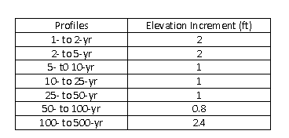
Methods for evaluating climate change data and potential future flooding patterns
Suburban/Exurban Flooding Methodology*
Reviewed water surface profiles (Des Plaines River, Addison Creek, Silver Creek - Aug 2010 USACE report) to identify incremental elevation differences between the various storm profiles
Based on these incremental differences and frequency shift identified based on future rainfall amounts, drawing a future 100-yr flood plain limit approximately half way between the existing FEMA 100- and 500-yr flood plain limits would be appropriate for identifying routes impacted along the Des Plaines River & creeks for future conditions.
Des Plaines River Elevations
Sources: USACE, 2010

Slide 23
Methods for evaluating climate change data and potential future flooding patterns
Suburban/Exurban Flooding Key Findings *
Limited expansion of floodplain areas impacting bus routes
  Across region, few areas with 500 year floodplain concerns with collocation with bus routes
  Initial screen of routes already included 100 + 500 year floodplain limits
  Some spots may have more frequent / severe flooding
LIMITATION: Approach is VERY broad brush, does not account for mitigation projects under way that are altering floodplain limits.
* Based on available data, no local or regional hydraulic/hydrologic modeling; significant manual correction/review of proposed lines required.

Slide 24
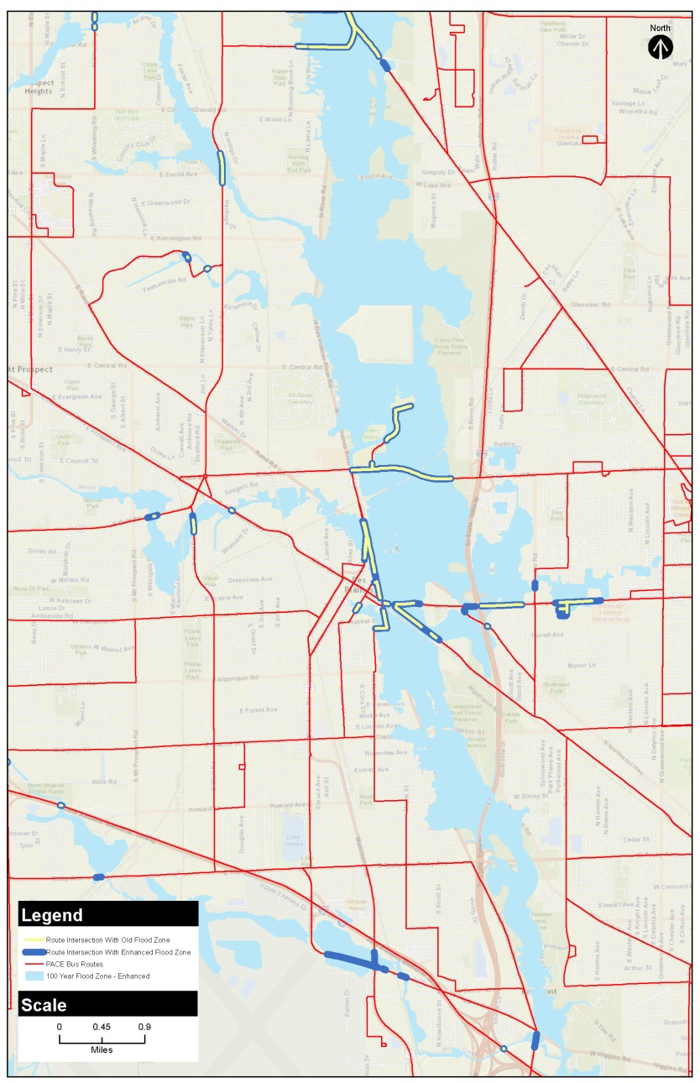
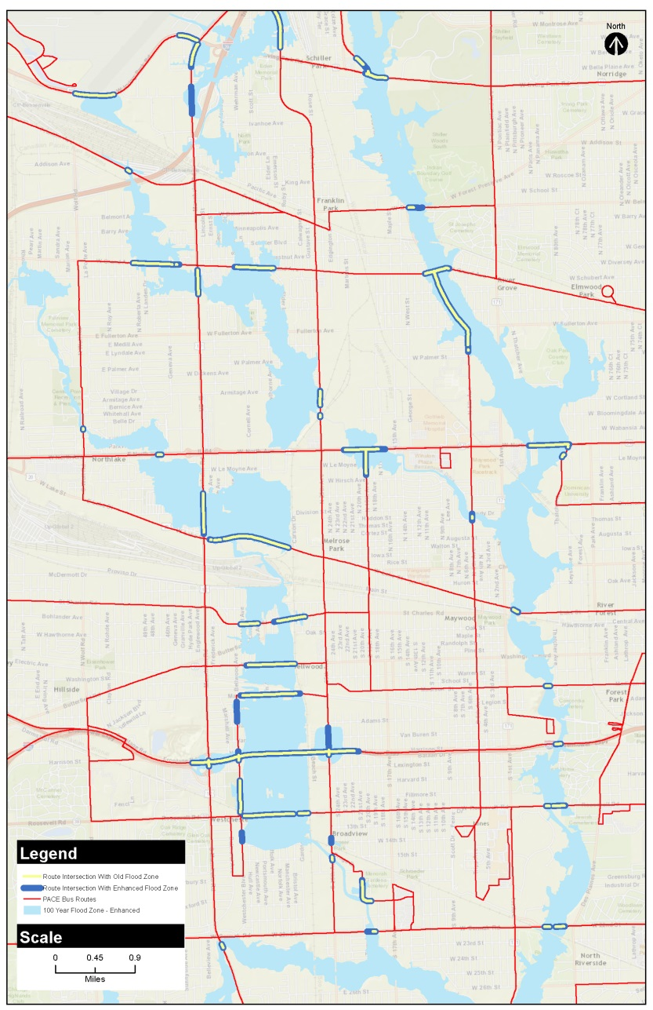
Suburban Flooding Data Analysis

Slide 25
reroute impact analysis

Slide 26
Task 4: Resilience Plan
4
Scope / Tasks
Deliverables
Documented reroutes for prioritized CTA and Pace routes
Estimated cost and revenue impacts
Documented customer communication strategies
Inventoried potential mitigation projects and recommendations, with suggested next steps for items outside agencies’ control
Summarized findings in project reports
Reroute recommendations with maps and impact assessment
Reroute communication plans
Flood mitigation strategies plan
Draft and final project reports
Working meetings with operations and service planning staff
Working meetings with communications staff
Steering Committee meetings
Meetings

Slide 27
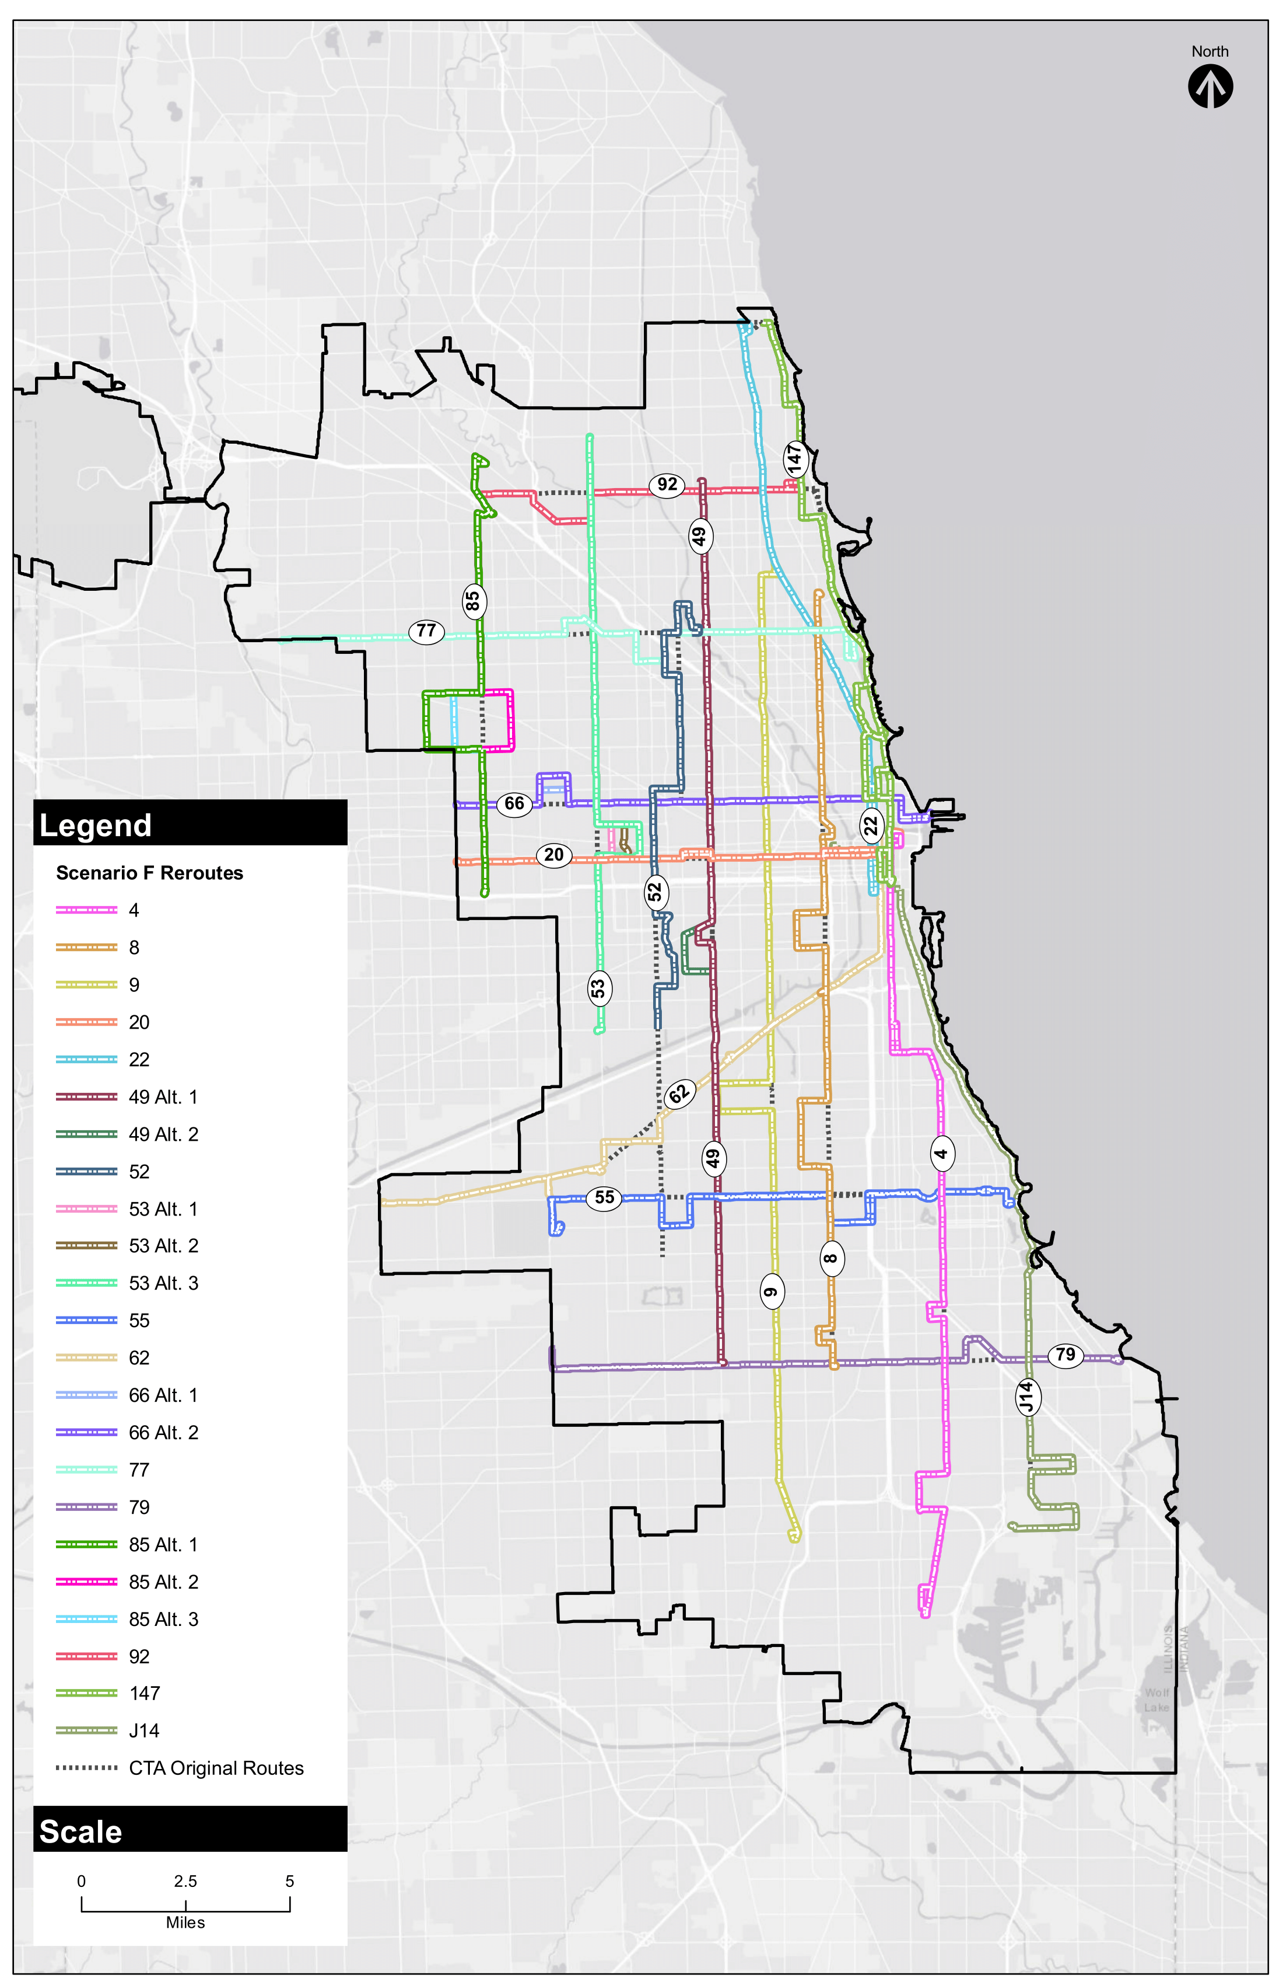
Final Reroutes
CTA Reroutes Scenario F Routes
4 8 9 J14 20 22 X49 52 | 53 55 62 66 77 79 85 92 147

Slide 28
Final Reroutes – Impact Analysis
Route | # of CTA-reported Flooding Incident Areas | Change in # CTA Flooding Incident Areas with Reroute | Missed Bus Stops with Reroute | Avg Riders Impacted Per Day from Reroute
4 | 34 | 0 | 16 | 2
8 | 14 | -7 | 36 | 336
9 | 41 | -6 | 4 | 63
J14 | 7 | 0 | 0 | 0
20 | 9 | +1 | 7 | 44
22 | 3 | 0 | 0 | N/A
49 | 66 | -23 | 3 | 11
49a | 60 | -29 | 8 | 98
52 | 5 | -24 | 98 | 750
53 | 27 | -9 | 9 | 155
53 Alt 1 | 27 | -9 | 9 | 155
53 Alt 2 | 33 | -3 | 9 | 155
55 | 4 | -6 | 18 | 253
62 | 38 | 0 | 15 | 87
66 | 21 | -1 | 5 | 21
66 Alt 1 | 31 | +9 | 5 | 21
77 | 8 | -3 | 14 | 224
79 | 21 | -3 | 12 | 87
85 E | 6 | +4 | 14 | 72
85 W | 4 | +2 | 14 | 72
85 Nar | 0 | -2 | 14 | 72
92 | 12 | +3 | 15 | 31
147 Alt 1 | 18 | -3 | 5 | 78
147 Alt 2 | 19 | -2 | 5 | 78
147 Alt 1&3 | 20 | -1 | 2 | 78
147 Alt 2&3 | 22 | +1 | 2 | 78

Slide 29
Final Reroutes – Impact Analysis
 | Travel Time per Trip (minutes) |  |  |  |  | Change in Travel Time per Trip (minutes)
Route | Existing | Reroute (Base) | Reroute (+Low) | Reroute (+Mod) | Reroute (+High) | Reroute (Base) | Reroute (+Low) | Reroute (+Mod) | Reroute (+High)
4 | 91 | 97 | 102 | 112 | 126 | 6 | 11 | 21 | 35
8 | 93 | 105 | 110 | 120 | 136 | 12 | 17 | 28 | 43
9 | 113 | 119 | 125 | 137 | 155 | 7 | 12 | 24 | 42
J14 | 58 | 63 | 66 | 72 | 82 | 5 | 8 | 14 | 24
20 | 60 | 62 | 65 | 71 | 80 | 2 | 5 | 11 | 20
22 | 76 | 76 | 79 | 87 | 98 | 0 | 4 | 11 | 23
49 | 92 | 94 | 99 | 108 | 122 | 2 | 7 | 16 | 30
49a | 92 | 96 | 100 | 110 | 124 | 4 | 8 | 18 | 32
52 | 81 | 71 | 74 | 81 | 92 | -10 | -6 | 1 | 11
53 | 72 | 75 | 78 | 86 | 97 | 3 | 6 | 14 | 25
53 Alt 1 | 72 | 77 | 80 | 88 | 99 | 5 | 8 | 16 | 27
53 Alt 2 | 72 | 78 | 82 | 90 | 101 | 6 | 10 | 18 | 29
55 | 51 | 58 | 61 | 67 | 75 | 8 | 10 | 16 | 25
62 | 73 | 76 | 80 | 87 | 99 | 4 | 7 | 15 | 26
66 | 65 | 67 | 70 | 76 | 86 | 2 | 5 | 12 | 22
66 Alt 1 | 65 | 69 | 72 | 79 | 89 | 4 | 7 | 14 | 25
77 | 68 | 78 | 82 | 90 | 101 | 10 | 14 | 22 | 33
79 | 71 | 73 | 76 | 83 | 94 | 2 | 5 | 12 | 23
85 E | 52 | 56 | 58 | 64 | 72 | 4 | 7 | 12 | 21
85 W | 52 | 56 | 58 | 64 | 72 | 4 | 7 | 12 | 21
85 Nar | 52 | 59 | 61 | 67 | 76 | 7 | 10 | 16 | 25
92 | 39 | 43 | 45 | 49 | 55 | 4 | 6 | 10 | 16
147 Alt 1 | 60 | 73 | 76 | 83 | 94 | 13 | 16 | 23 | 34
147 Alt 1 | 60 | 78 | 81 | 89 | 101 | 18 | 21 | 29 | 41
147 Alt 1&3 | 60 | 71 | 74 | 81 | 92 | 11 | 14 | 21 | 32
147 Alt 2&3 | 60 | 76 | 79 | 87 | 98 | 16 | 19 | 27 | 38

Slide 30
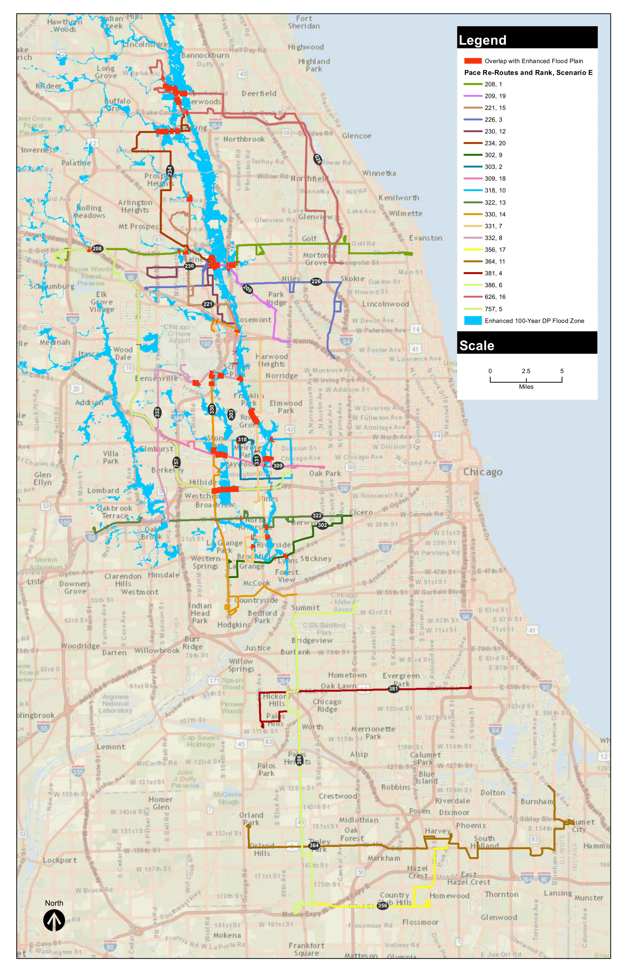
Pace Final Reroutes

Slide 31
Pace Final Reroutes – Impact Analysis
Route Change
Route | # of Flooding Incident Areas | Change # of Flooding Incident Areas | Missed Bus Stops | Existing ADR | ADR with Reroute | % Change | Impacted Riders
208 | 1 | -1 | 34 | 1,847 | 1,687 | -8.7% | 160
209 | 1 | 0 | 6 | 369 | 368 | -0.3% | 1
221 | 0 | 0 | 34 | 726 | 683 | -5.9% | 43
226 | 1 | 0 | 17 | 696 | 694 | -0.3% | 2
230 | 1 | 0 | 7 | 370 | 365 | -1.4% | 5
234 | 0 | 0 | 30 | 266 | 248 | -6.8% | 18
302 | 2 | 0 | 2 | 551 | 546 | -0.9% | 5
303 | 5 | -5 | 138 | 1,130 | 515 | -54.4% | 615
309 | 2 | 0 | 25 | 881 | 820 | -6.9% | 61
318 | 3 | -1 | 32 | 2,402 | 926 | -61.5% | 1476
322 | 2 | 0 | 2 | 2,243 | 2,175 | -3.0% | 68
330 | 6 | 2 | 16 | 1,223 | 948 | -22.5% | 275
331 | 4 | -1 | 33 | 1,142 | 1,080 | -5.4% | 62
332 | 4 | 1 | 19 | 629 | 477 | -24.2% | 152
356 | 2 | 0 | 7 | 581 | 567 | -2.4% | 14
364 | 1 | 0 | 0 | 2,043 | 2,043 | 0.0% | 0
381 | 1 | -1 | 7 | 3,669 | 3,631 | -1.0% | 38
386 | 1 | -1 | 10 | 1,423 | 1,344 | -5.6% | 79
626 | 0 | 0 | 0 | 346 | 346 | 0.0% | 0
757 | 0 | 0 | 0 | 210 | 210 | 0.0% | 0

Slide 32
Pace Final Reroutes – Impact Analysis
 | Travel Time per Trip (Minutes) |  |  |  |  | Change in Travel Time per Trip
 | Existing | Reroute (Base) | Reroute (+ Low) | Reroute (+ Mod) | Reroute (+ High) | Reroute (Base) | Reroute (+ Low) | Reroute (+ Mod) | Reroute (+ High)
208 | 95 | 73 | 77 | 84 | 95 | -22 | -18 | -11 | 0
209 | 30 | 28 | 29 | 32 | 36 | -2 | -1 | 2 | 6
221 | 55 | 45 | 47 | 52 | 59 | -10 | -8 | -3 | 4
226 | 56 | 44 | 46 | 50 | 57 | -12 | -10 | -5 | 1
230 | 40 | 33 | 35 | 38 | 43 | -7 | -5 | -2 | 3
234 | 46 | 34 | 35 | 39 | 44 | -13 | -11 | -7 | -2
302 | 34 | 36 | 38 | 41 | 47 | 3 | 4 | 8 | 13
303 | 45 | 40 | 42 | 46 | 52 | -5 | -3 | 1 | 7
309 | 45 | 48 | 50 | 55 | 62 | 3 | 5 | 10 | 17
318 | 31 | 39 | 41 | 45 | 51 | 9 | 10 | 14 | 20
322 | 60 | 67 | 70 | 76 | 86 | 7 | 10 | 16 | 26
330 | 64 | 70 | 74 | 81 | 91 | 6 | 10 | 17 | 27
331 | 55 | 60 | 63 | 69 | 78 | 5 | 8 | 14 | 23
332 | 69 | 63 | 66 | 72 | 81 | -6 | -3 | 3 | 13
356 | 33 | 35 | 37 | 40 | 46 | 3 | 4 | 8 | 13
364 | 90 | 90 | 95 | 104 | 117 | 0 | 5 | 14 | 27
381 | 54 | 53 | 55 | 60 | 68 | -2 | 1 | 6 | 14
386 | 67 | 70 | 74 | 81 | 91 | 3 | 7 | 14 | 24
626 | 70 | 75 | 79 | 86 | 98 | 5 | 9 | 16 | 28
757 | 63 | 64 | 67 | 74 | 83 | 2 | 5 | 11 | 21

Slide 33
Pace Final Reroutes – Impact Analysis
 | Cost per Trip |  |  |  |  | Change in Cost per Trip
Route | Existing | Reroute (Base) | Reroute (+ Low) | Reroute (+ Mod) | Reroute (+ High) | Reroute (Base) | Reroute (+ Low) | Reroute (+ Mod) | Reroute (+ High)
208 | $119.78 | $92.53 | $97.15 | $106.41 | $120.29 | -$27.25 | -$22.63 | -$13.37 | $0.51
209 | $38.03 | $35.49 | $37.26 | $40.81 | $46.14 | -$2.54 | -$0.76 | $2.79 | $8.11
221 | $69.71 | $57.04 | $59.89 | $65.59 | $74.15 | -$12.68 | -$9.82 | -$4.12 | $4.44
226 | $70.35 | $55.14 | $57.89 | $63.41 | $71.68 | -$15.21 | -$12.45 | -$6.94 | $1.33
230 | $50.70 | $41.83 | $43.92 | $48.10 | $54.38 | -$8.87 | -$6.78 | -$2.60 | $3.68
234 | $58.31 | $42.46 | $44.58 | $48.83 | $55.20 | -$15.84 | -$13.72 | -$9.47 | -$3.11
302 | $40.84 | $43.88 | $46.08 | $50.46 | $57.05 | $3.05 | $5.24 | $9.63 | $16.21
303 | $54.85 | $48.76 | $51.20 | $56.07 | $63.39 | -$6.09 | -$3.66 | $1.22 | $8.53
309 | $54.85 | $58.51 | $61.44 | $67.29 | $76.06 | $3.66 | $6.58 | $12.43 | $21.21
318 | $37.18 | $47.54 | $49.92 | $54.67 | $61.80 | $10.36 | $12.74 | $17.49 | $24.62
322 | $73.14 | $81.06 | $85.11 | $93.22 | $105.38 | $7.92 | $11.98 | $20.08 | $32.24
330 | $78.01 | $85.33 | $89.59 | $98.13 | $110.93 | $7.31 | $11.58 | $20.11 | $32.91
331 | $67.04 | $73.14 | $76.79 | $84.11 | $95.08 | $6.09 | $9.75 | $17.07 | $28.04
332 | $83.50 | $76.18 | $79.99 | $87.61 | $99.04 | -$7.31 | -$3.50 | $4.11 | $15.54
356 | $47.86 | $51.54 | $54.12 | $59.27 | $67.01 | $3.68 | $6.26 | $11.41 | $19.14
364 | $132.54 | $132.54 | $139.17 | $152.42 | $172.30 | $0.00 | $6.63 | $19.88 | $39.76
381 | $59.96 | $58.30 | $61.21 | $67.04 | $75.79 | -$1.67 | $1.25 | $7.08 | $15.82
386 | $74.40 | $77.73 | $81.62 | $89.39 | $101.05 | $3.33 | $7.22 | $14.99 | $26.65
626 | $81.60 | $87.42 | $91.80 | $100.54 | $113.65 | $5.83 | $10.20 | $18.94 | $32.06
757 | $76.18 | $78.01 | $81.91 | $89.72 | $101.42 | $1.83 | $5.73 | $13.53 | $25.23

Slide 34
resilience strategies

Slide 35
Current Regional Work
CMAP ON TO 2050 Strategies
Metropolitan Planning Council
Center for Neighborhood Technology
City of Chicago / Rockefeller Foundation 100 RC

Slide 36
General Recommendations
Street Flooding and Viaducts
Street surface (pavement): The pavement must grade toward the drainage structures. If the street is in disrepair or the drainage structures are not located at the low points of the surface grade, flooding will occur.
Drainage structures: The drainage structures collect surface runoff and route the water to underground storm sewer pipes. The structures are mostly inlets and catch basins, but other types of structures may be utilized, such as French drains. It is imperative that these structures be kept clear of debris and be vacuumed regularly and as necessary.

Slide 37
General Recommendations
Street Flooding and Viaducts
Storm sewer: Underground pipe may be composed of masonry or metal. Typically, a water department will investigate a poorly performing drain system by televising the pipe. The video capture will show if and where a pipe collapse or blockage has occurred.
Pump stations: In some cases low-lying areas require a mechanical means of pumping the water up, out, and into the existing storm sewer system, which lies higher than the viaduct elevation.

Slide 38
General Recommendations
Green Infrastructure
Element | Description / What it Accomplishes
Rain gardens and urban agriculture | A landscaped, man-made depression that both improves water quality and reduces flooding by promoting infiltration. Can be used to grow local foodstuffs.
Bioretention basins | Stormwater is held in a bioretention basin and slowly filters into the ground
Downspout Disconnection and Rainwater Harvesting / Rain Barrels | New gutters and down-spouts convey the runoff from the roof; down-spouts are routed into storage (cisterns or barrels) rather than stormwater system
Permeable Pavement | Stormwater is detained in a subsurface storage layer (drain rock) or slowly infiltrates into the subsurface soils to recharge groundwater
Bioswale | Open vegetated channels designed to detain and promote filtration of stormwater runoff
Trees / Street planting | Aside from reducing air pollution and heating & cooling costs, trees also absorb excess water from storm events
Flow through planters | Placed at or above ground level, flow-through planters do not infiltrate the ground but can help in constrained sites with poorly draining soils, steep slopes, or contaminated areas
Stormwater conveyance | Sidewalk or street runoff is conveyed to a bioretention basin in a stormwater node

Slide 39
General Recommendations
Data and Technology
Regional data collection and forecasting
Collaboration on Smart Cities initiatives
Policies
CTA participation in City of Chicago Department of Transportation’s Division of Infrastructure Management (CDOT’s DOIM) - Office of Underground Coordination (OUC)
CTA participation in OEMC Event Management center
Pace participation in COG / coalition emergency response centers

Slide 40
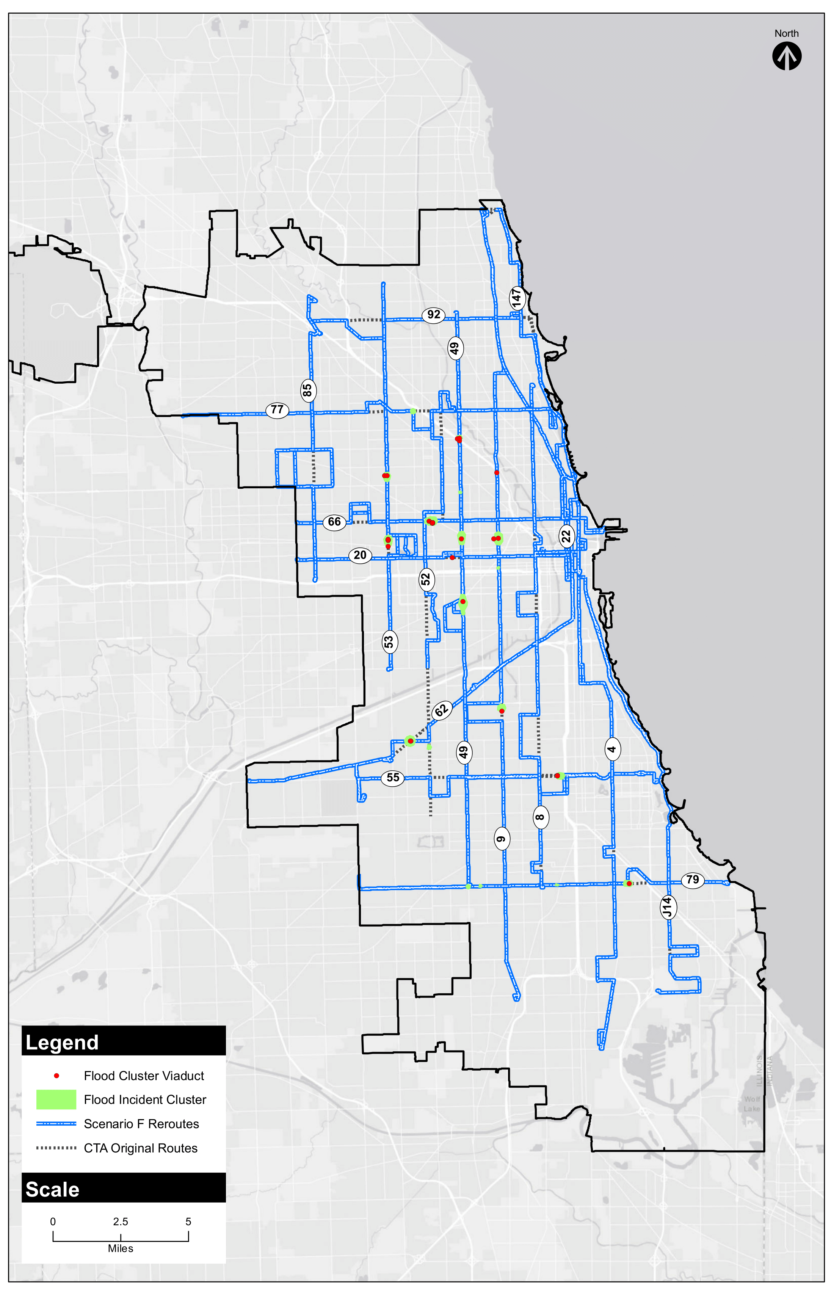
CTA Specific
Recommendations

Slide 41
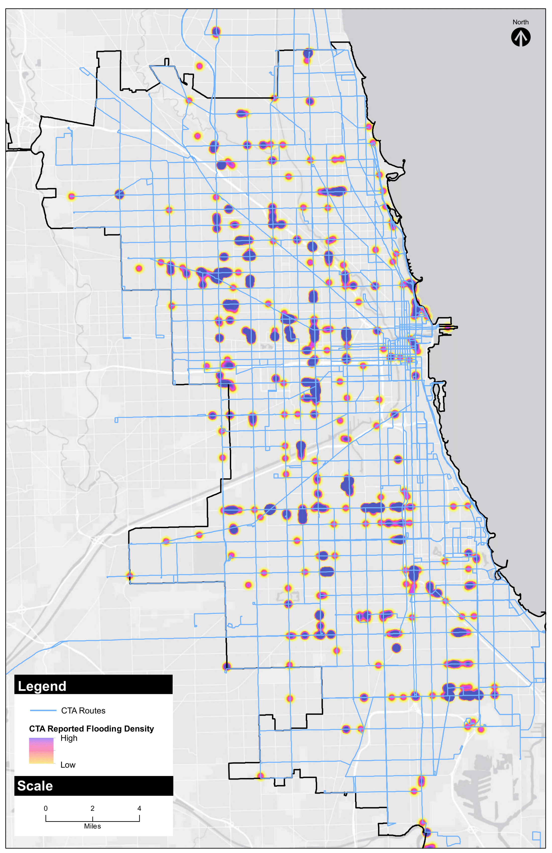
CTA Specific
Recommendations

Slide 42
CTA Specific Recommendations
Street Flooding and Viaducts
Cluster ID | Scenario F Location | Rail nearby | Acres | CTA Flood Incidents Count | OEMC Flood Incidents Count | Capital Improvement Projects Nearby | Viaducts Count
1 | Belmont @ Kimball |  | 166 | 4 | 6 | Yes (Dec 2013, Water) | 0
2 | Western @ I-90/94 |  | 163 | 4 | 4 | No | 3
3 | Ashland @ I-90/94 |  | 28 | 0 | 0 | No | 1
4 | Pulaski @ Cortland | Yes | 346 | 8 | 4 | No | 2
5 | Western @ Hirsch |  | 64 | 3 | 6 | No | 0
6 | Sacramento @ Chicago | Yes | 559 | 16 | 6 | Yes (Sep 2013, Arterial Surfacing) | 7
7 | Western @ Kinzie | Yes | 516 | 12 | 7 | Yes (Dec 2015, Water) | 1
8 | Ashland @ Kinzie | Yes | 590 | 17 | 5 | No | 2
9 | Pulaski @ Kinzie | Yes | 481 | 12 | 7 | No | 6
10 | Madison @ Rockwell | Yes | 40 | 2 | 1 | No | 1
11 | Ashland @ I-290 |  | 69 | 3 | 0 | No | 0
12 | Western @ Ogden | Yes | 752 | 18 | 2 | Yes (Dec 2013, Arterial Surfacing) | 1
13 | Pulaski @ Ogden | Yes | 45 | 2 | 0 | No | 0
14 | Ashland @ W 41st | Yes | 344 | 8 | 2 | No | 1
15 | Archer @ W 48th | Yes | 549 | 24 | 3 | No | 2
16 | Kedzie @ W 48th | Yes | 136 | 3 | 0 | Yes (Mar 2015, Water) | 0
17 | Garfield @ Shields | Yes | 316 | 7 | 3 | Yes (Aug 2014, Arterial Surfacing) | 2
18 | W 79th @ Eggleston |  | 65 | 1 | 0 | No | 0
19 | E 79th @ Greenwood | Yes | 330 | 8 | 21 | Yes (Dec 2013, Water) | 1
20 | W 79th @ Hamilton | Yes | 71 | 3 | 0 | No | 0
21 | w 79th @ Western |  | 130 | 3 | 0 | No | 0

Slide 43
CTA Action Matrix
Project/Policy | Agency/ Organization | Cost | Notes
Viaduct improvement projects | CREATE public and private partners; Metra; railroads; CDOT; CDWM | $$$ | CREATE Viaduct Improvement Program completed in 2015. Negotiate additional funding for expansion of that program along with remaining CREATE projects.
Underground construction projects | CDWM, sister water departments | $$$ | Such projects may be initiated through Mayoral, Aldermanic, sister-agency and/or public (311) requests.
Clearance of drains of debris prior/during storm | OEMC; Chicago Streets & Sanitation | $ | Proactive pre-storm preparation
Coordination with other development/ utility/ roadwork projects | CDOT DOIM | $ | Potential participation in dotMaps system. Submittal of a project “hot list” for consideration by the Office of Underground Coordination. The benefit would be potential remediation of infrastructure-induced flooding while other capital projects are being carried out, thus minimizing costs and potential conflicts.
Green infrastructure | Chicago DPD and CDOT (Resilient Corridors Program) | $$ | As the Resilient Corridors program is expanded to additional corridors, CTA’s priority routes can be considered.
Ongoing monitoring and data collection | CTA (CleverCAD); OEMC 311 data CMAP; CDWM; CDOT; OEMC; MWRD; IDNR; FEMA; CNT; MPC | $ $$ | Use of flood report data to identify and monitor problem areas can be used to generate hot list for participation in OUC meetings (above) or to provide to Streets and Sanitation for debris clearance (above) Develop and enhance/maintain City and/or regional database of flood incidents, forecasts, risk factors, and mitigation measures

Slide 44
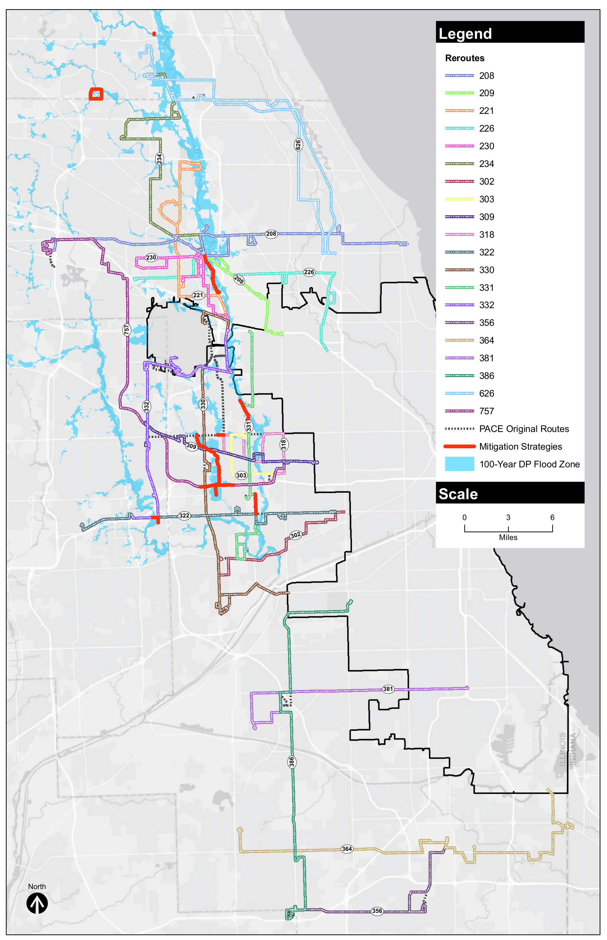
Pace Specific
Recommendations

Slide 45
Pace Specific Recommendations
Route | Mitigation Strategy
209, 226 | IDNR-OWR has built two flood control projects in this area in the last decade that should solve most of the flooding problems shown. It is uncertain whether floodplain maps were ever updated with the results of these projects; it might be the method of handling the enhanced flood plain in this area that flags these areas as potential problems. These routes should experience infrequent flooding at the worst.
230 | PACE needs to lobby Congress regarding funding for the Corps Des Plaines River Levee 9. The Des Plaines River project was authorized by Congress in the Water Resources Development Act of 2016. Now Congress has to include funding for the project in budget.
234 | MWRDGC is studying reservoir expansion on Buffalo Creek upstream of this flooding problem. Need to coordinate with MWRDGC to move this project forward.
303, 309, 330 | MWRDGC’s Addison Creek project that is moving into the design phase should reduce the flood frequency for these routes.
318 | MWRDGC’s Addison Creek project and a study by IDOT on North Avenue at Silver Creek should reduce the flooding frequency along this route.
331 | The Corps Des Plaines River Levee 4 with two closure structures should reduce the flood frequency for this route. The Grand Avenue closure structure would close Grand Avenue but will allow Des Plaines River Road to remain open, and generally would be closed between the 10 and 50-yr flood event. The closure structure at Des Plaines River Road and 5th Avenue would close Des Plaines River Road here during the 100-yr events.
332 | DuPage County Stormwater did not show the portion of this route on 22nd Street flooding. They will need to coordinate with Elmhurst regarding solutions for the York Road underpass flooding. The portion of the route along Irving Park Road and Bensenville Ditch may have been addressed when Irving Park and Bensenville Ditch were relocated for the O’Hare Airport Expansion.
626 | The Aptakisic Creek flooding along a portion of this route should be coordinated with the Lake County Stormwater Management Commission. The roads are IDOT’s jurisdiction at this location and talks about any flooding problems here should also be discussed IDOT.
757 | The flooding shown along I-290 portion of this route should be addressed when IDOT reconstructs I-290. PACE needs to work with IDOT on scheduling this reconstruction.

Slide 46
Pace Action Matrix
Project/Policy | Agency/ Organization | Cost | Notes
Clearance of drains of debris prior/during storm | Local DOT and Departments of Streets & Sanitation | $ | Proactive pre-storm preparation
Coordination with other development/ utility/ roadwork projects | Local Councils of Governments | $ | Participate in TIP planning process to reinforce priority hotlist
Watershed planning councils | MWRD, local departments of planning, water and transportation | $ $$ | Identify risk areas and problems, with corresponding mitigation projects and policies Prepare stormwater master plans to address urban flooding; five pilot studies under way or complete; expand to other high-priority / high-flood risk areas
Ongoing monitoring and data collection | Pace operating systems; local 311/911 services; smart cities service providers County and municipal stormwater departments; CMAP; IDNR; FEMA; CNT | $ $$ | Use of flood report data to identify and monitor problem areas can be used to generate hot list for participation in infrastructure planning meetings (above); provide to streets and sanitation departments for debris clearance (above) Develop and enhance/maintain county and/or regional database of flood incidents; rainfall, water level, and flood forecasts; risk factors; and mitigation measures
Cost-sharing for local capital improvement projects to alleviate flooding issues | County DOTs, County, municipality, stormwater agencies | $$ | Coordinate problem diagnosis and solution planning among agencies
Cost-sharing on major capital improvement projects pertaining to riverine flooding | County and municipal stormwater departments; MWRDGS, IDOT, US Army Corps of Engineers | $$$ | Projects include reconstruction of a segment of I-290 (IDOT), Des Plaines River Levee 9 (US ACE), Buffalo Creek reservoir expansion (MWRDGC), Addison Creek (in design phase, MWRDGC), Silver Creek (IDOT), among others

Slide 47
Pace Action Matrix, continued
Project/Policy | Agency/ Organization | Cost | Notes
Viaduct improvement projects | CREATE public and private partners; Metra; railroads; local DOT | $$$ | Funding of CREATE projects is pending.
Underground construction projects | Local and county departments of water management and transportation | $$$ | Such projects may be initiated through Mayoral, Aldermanic, sister-agency and/or public (311) requests.
Green infrastructure | local departments of planning, water and transportation | $$ | Implement carefully curated palettes of green infrastructure for maximum benefit

Slide 48

Flooding Resilience Plan for Bus Operations
March 2018

